Slide 1
Creative Processes
Interactive Media
Unit 1

Slide 2
Starter – 5 Minutes
Answer the following on your whiteboards:
How do you think a group would start the design process of a product?
What are the first things they will do to get ideas together?

Slide 3
Learning Outcomes
Understand the different creative planning processes.
Describe how the different processes are used for different purposes.
Explain how different processes can convey the same information differently.

Slide 4
Planning Processes
The planning processes for an Interactive Media product can be broken into two categories:
Creative
Technical
Both are equally as necessary but cover different parts of the planning process.

Slide 5
Creative Processes
The purpose of the creative processes is to start pulling together ideas for the product.
At this point in the project, the developer (you) will have been given a brief.
Using this brief, you can start pooling together ideas and information that will help you design.

Slide 6
Examples
Examples include, but not limited to:
Storyboards
Mood-boards
Scripts
What do these have in common?

Slide 7
Portfolio Setup
Create a new heading in your portfolio: Creative Processes (Heading 1).
Create another heading:
Scripts (Heading 2)
Storyboards (Heading 2)
Mood Boards (Heading 2)

Slide 8
Task 1 – Definitions
Look up the following on the internet and add your answers under the appropriate heading in your portfolio:
What is the purpose of a script?
How is a script different to a storyboard?
What would you typically find on a mood-board?
Which of the three mentioned methods would be best for the box for a video game?

Slide 9
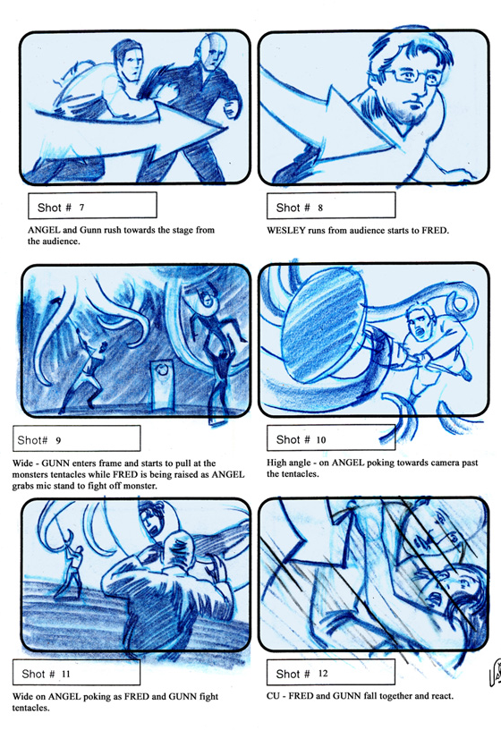
Storyboard
A storyboard is a series of drawings created by hand or digitally with explanations of each.
They are used for organising filming so you know what you need, and to help visualise what each scene will look like before filming.
They can also help to plan an animation or video and are usually drawn by hand.

Slide 10
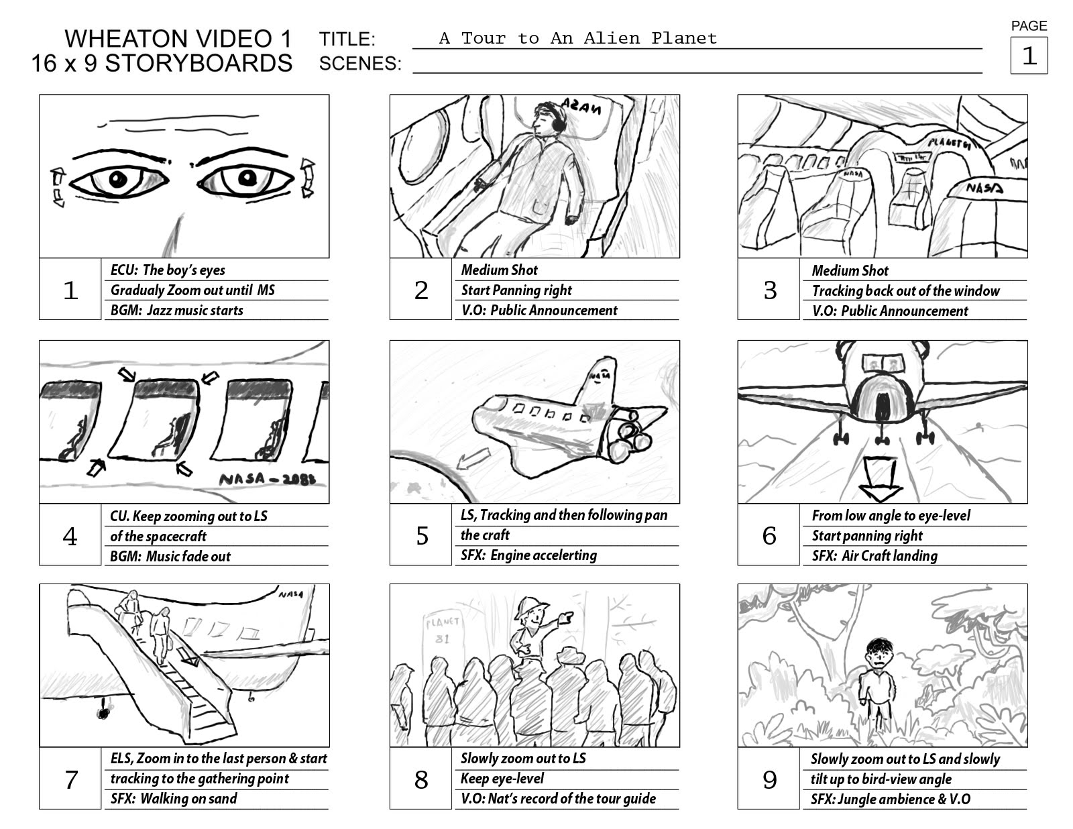
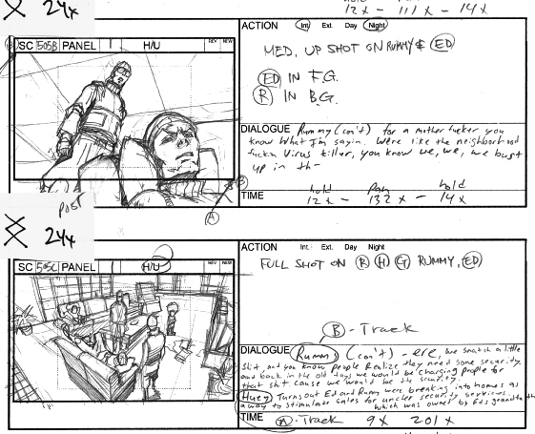
Storyboard – Example

Slide 11

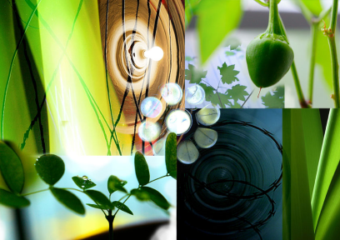
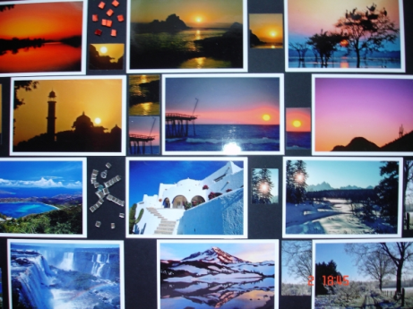
Mood-Board
A mood-board is a collage (either digital or on paper) of objects (images, colours, screenshots, patterns, text etc.) which try to capture a feeling, theme or design.
They are typically used in interior design and advertising.
Often, they are used to generate ideas for a client, to meet their approval before moving further in the design process.

Slide 12
Mood-Board – Why?
They can be used to help generate ideas by having a central place to put any pre-existing ideas that can be seen by people on the design team and by the client.
They can be used to share ideas and concepts for websites, graphic projects, games, movies etc.
They can also be used to gain feedback from the client about a particular design or concept.

Slide 13
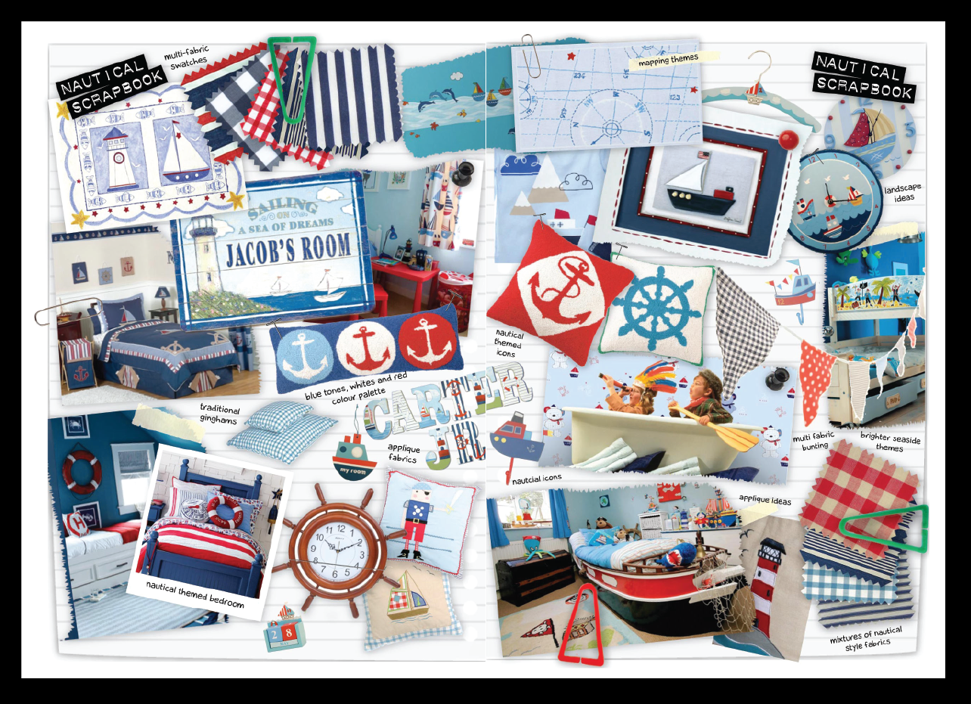
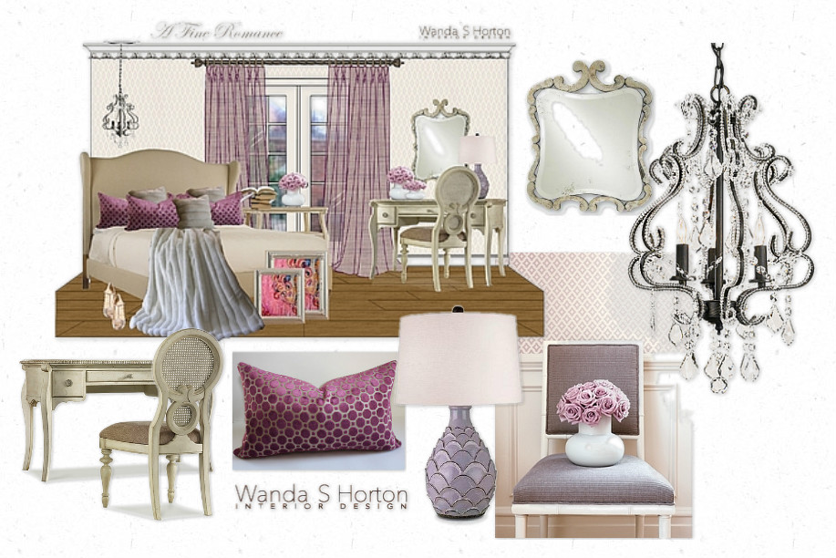
Casual Vs. Structured

Slide 14
The Creation Process
Collect a range of materials (images, text, colours etc.)
Arrange them together on a page.
Remove any items which do not fit in with the theme.
Use the mood board throughout production to ensure the theme is being adhered to.

Slide 15
Task 2 – Definitions
Using this presentation and information from the internet, make sure you have definitions of the following in your portfolio:
Scripts
Storyboards
Moodboards

Slide 16
Task 3 – Mood Board
The following task will go under the Mood Boards heading. Make sure to include the brief in the document.
Make the mood board in Publisher then paste a screenshot in the portfolio.
Create a digital mood-board for one of the following client briefs:
Brief 1: A new interior design company is considering a new range of bedroom furniture for girls with a theme of “racing”.
Brief 2: An outward bounds company is planning to develop a new set of adverts which convey the theme of “adventure”.
Brief 3: A local nursery is planning a new poster to advertise the business with the theme of “fun and learning”.

Slide 17
Extension
Choose a different brief from the previous task.
Create a digital mood-board for one of the following client briefs:
Brief 1: A new interior design company is considering a new range of bedroom furniture for girls with a theme of “racing”.
Brief 2: An outward bounds company is planning to develop a new set of adverts which convey the theme of “adventure”.
Brief 3: A local nursery is planning a new poster to advertise the business with the theme of “fun and learning”.

